Slide 1
IBM DATA SCIENCE CAPSTONE
BATTLE OF NEIGHBORHOODS

Slide 2
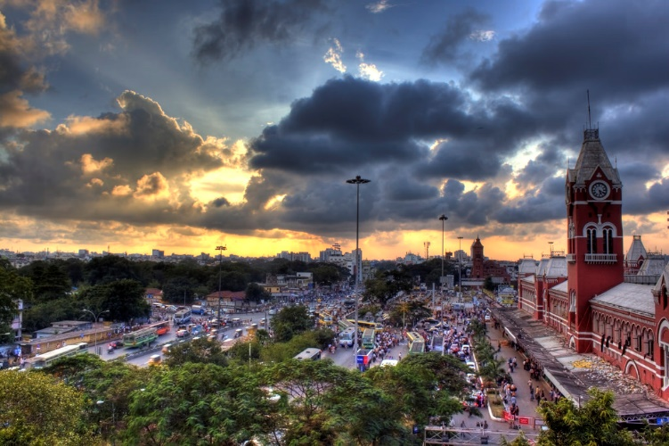
Optimal Locations for Hospitals in Chennai city

Slide 3
Introduction
Chennai is the capital of the Indian state of Tamil Nadu
It is the sixth-most populous city and fourth-most populous urban agglomeration in India.
Coronavirus disease (COVID-19) is an infectious disease caused by a newly discovered coronavirus.
The rising number of cases has resulted in a deepening healthcare crisis that has gripped several states.
The second wave has hit a country which was unprepared. This has led to increased no. of cases where the hospitals are overcrowded and there is also shortage of oxygen supply in some areas

Slide 4
Business Problem
List and visualize all the hospitals in and around the Chennai city
Identify the neighborhoods around the hospitals
What are all the best locations to open new public health centers
Identify areas that lack hospital centers compared to other areas
To alleviate over-crowding in hospitals and enhance the medical facilities to the citizens

Slide 5
Data Description
Chennai Postal codes
Data source: https://www.mapsofindia.com/pincode/india/tamil-nadu/ chennai/
Description: This data contains list of major boroughs and their postal codes
Geocoding API
Data source: https://developers.google.com/maps/documentation/geocoding/overview
Description: The Geocoding API provides a direct way to access these services via an HTTP request. We leverage this API to obtain latitude and longitudes of hospitals
Hospital Location information
Data source: https://nationalinsurance.nic.co.in/sites/default/files/Chennai%20PPN%20List%20of%20Hospitals.pdf
Description: The data source contains list of hospitals and their addresses which are located in and around the Chennai city
Foursquare API
Data source: https://developer.foursquare.com/
Description: Foursquare helps us identify the various venues near our neighborhood through we’ll able to identify the facilities around the hospitals

Slide 6
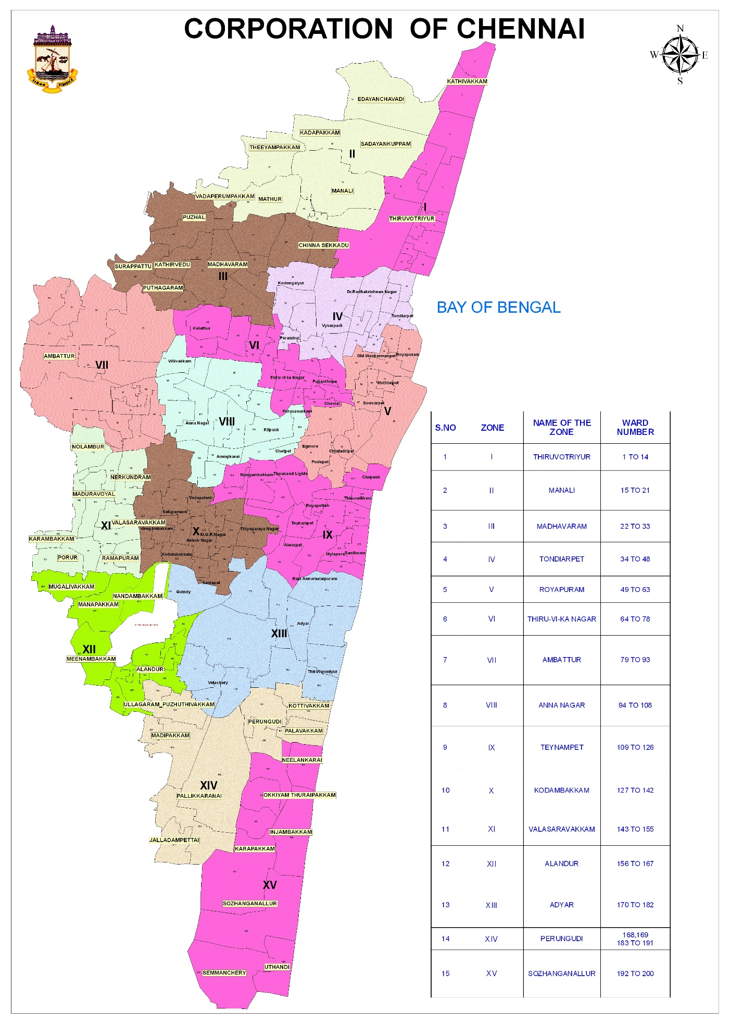
Chennai Zones

Slide 7
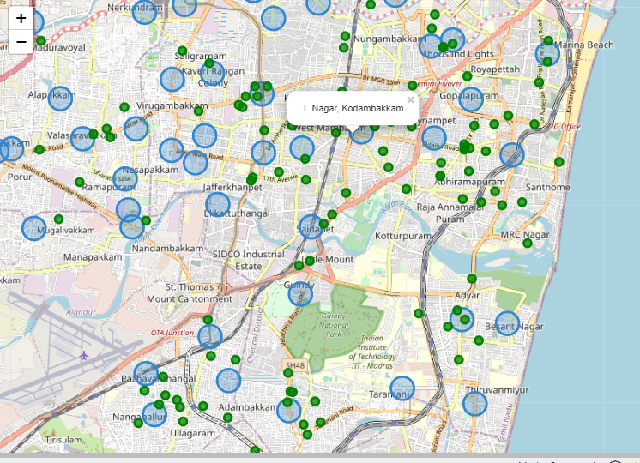
Hospital & Neighborhood Visualization

Slide 8
Methodology
In this project we will direct our efforts on detecting areas of Chennai that have low hospital density, particularly those with those with a lot of venues. We will limit our analysis to area ~5km around each neighborhood.
In first step we have collected the required **data: location and type (category) of every hospital and venue within 5km from each neighborhood center** We have obtained the hospital data separately along with the latitudes and longitudes
The next step is we group the venues based on their categories: Services, Sports, entertainment, Hospital and others
We one hot encode the venue categories. We identify their total in each neighborhood. The venue categories are put in to the group/bins specified above. Then we compute, no.of venue groups per hospital in a given neighborhood.
We use this information to identify areas with least hospitals via clustering.

Slide 9
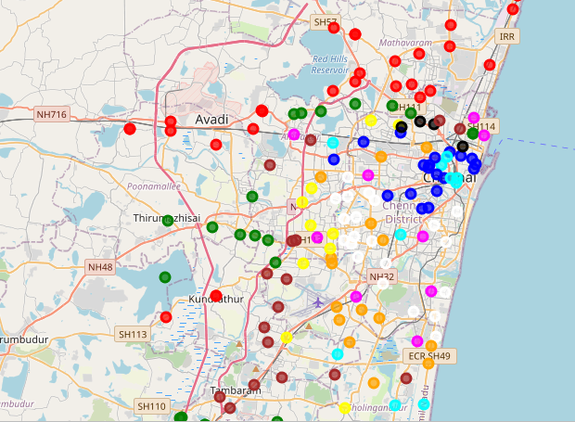
Clusters

Slide 10
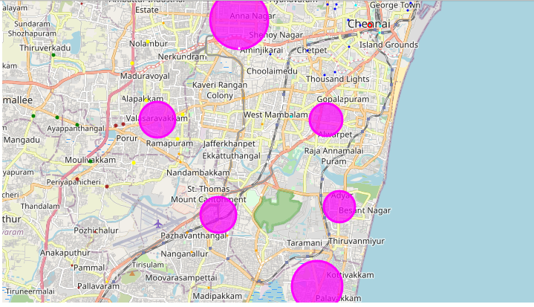
Clusters with Hospital Density

Slide 11
Conclusion
We’ve identified the areas with least hospital facilities
Hospital locations follow nash equilibrium
There is a need to increase COVID care centers throughout the city
We’ve identified locations which has more restaurants but fewer hospitals.
These restaurants/hotels can support the COVID cares to control the ongoing crisis

